Slide 1
Data Science Lecture – 1 : Introduction

Slide 2
What is data science? Misconception of Data science Data science examples Course objectives and Logistics Introduction to Matlab

Slide 3
What is data science?
Data science is the application of computational and statistical techniques to address or gain insight into some problem in the real world
Data science = statistics + data processing + machine learning + scientific inquiry + visualization + big data + business analytics + …

Slide 4


Slide 5
What is data science? Misconception of Data science Data science examples Course objectives and Logistics Introduction to Matlab

Slide 6
Data science is not ONLY machine learning
Machine learning involves the use of statistical algorithms that can assist with harnessing information that is difficult to view from raw data.
... but sometimes the best way to solve a problem is just by visualizing the data, for instance
Universe of machine learning problems
Problems solvable with “simple” ML (45%) |  | Unsolvable problems (50%)
Problems requiring “state of the art” ML (5%)

Slide 7
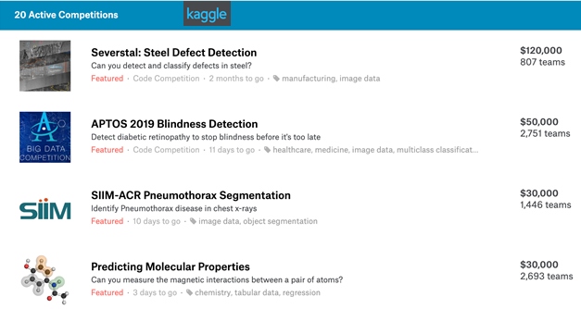
Data science is not ML competitions
Data science competitions (e.g. Kaggle) ask you to optimize a metric on a fixed data set. This may or may not solve the desired problem
Data science is the iterative cycle of designing, building and evaluating an algorithm to solve the real underlying question

Slide 8
Data science is not statistics
“Analyzing data computationally, to understand some phenomenon in the real world, you say? … that sounds an awful lot like statistics”
Not many statistics courses have lectures on data processing e.g. web scraping etc.

Slide 9
Data science is not big data
Sometimes, in order to truly understand and answer your question, you need massive amounts of data…
…But sometimes you don’t
Don’t create more work for yourself than you need to

Slide 10
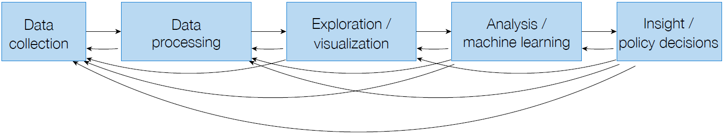
So what Really is data science?

Slide 11
What is data science? Misconception of Data science Data science examples Course objectives and Logistics Introduction to Matlab

Slide 12
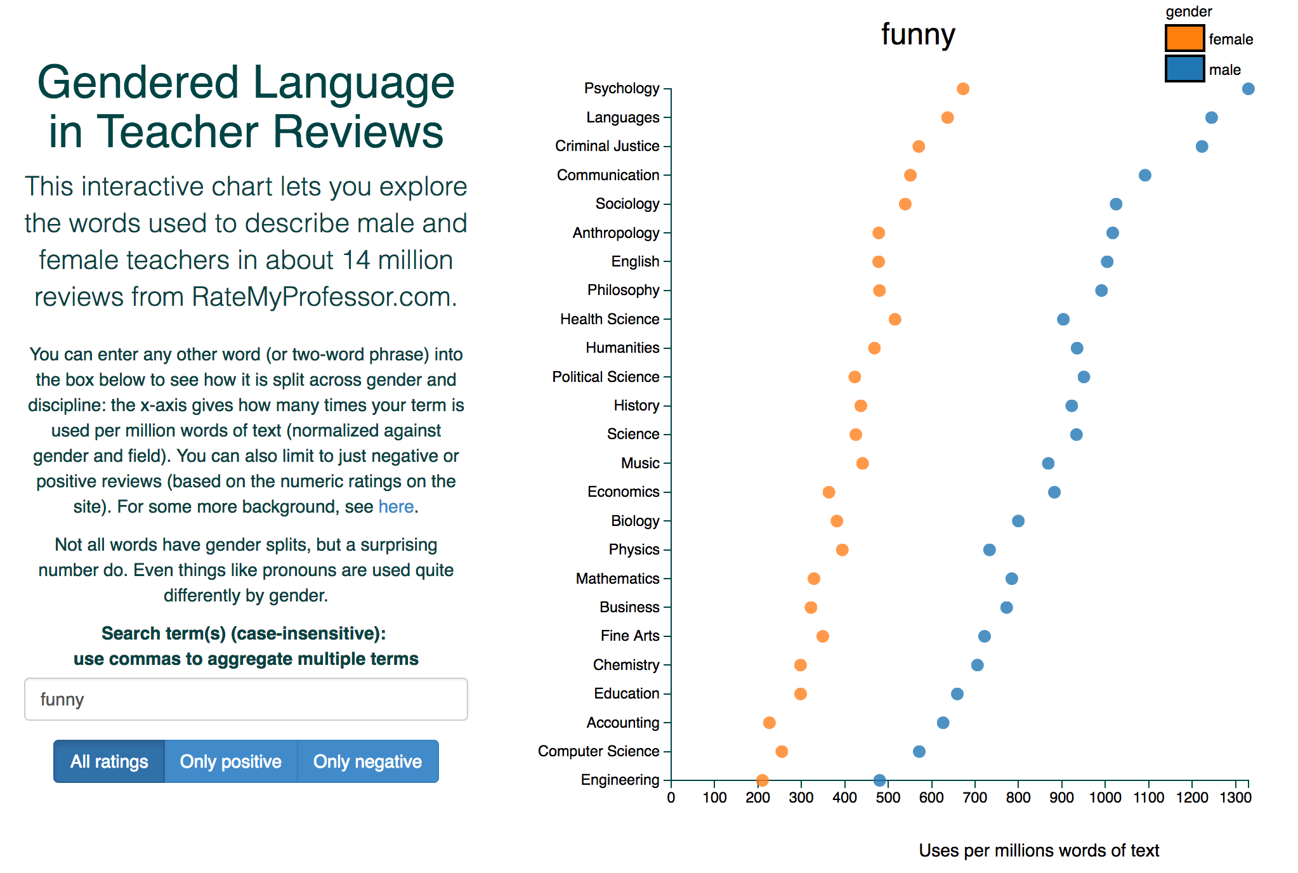
Gendered language in professor reviews
http://benschmidt.org/profGender/

Slide 13
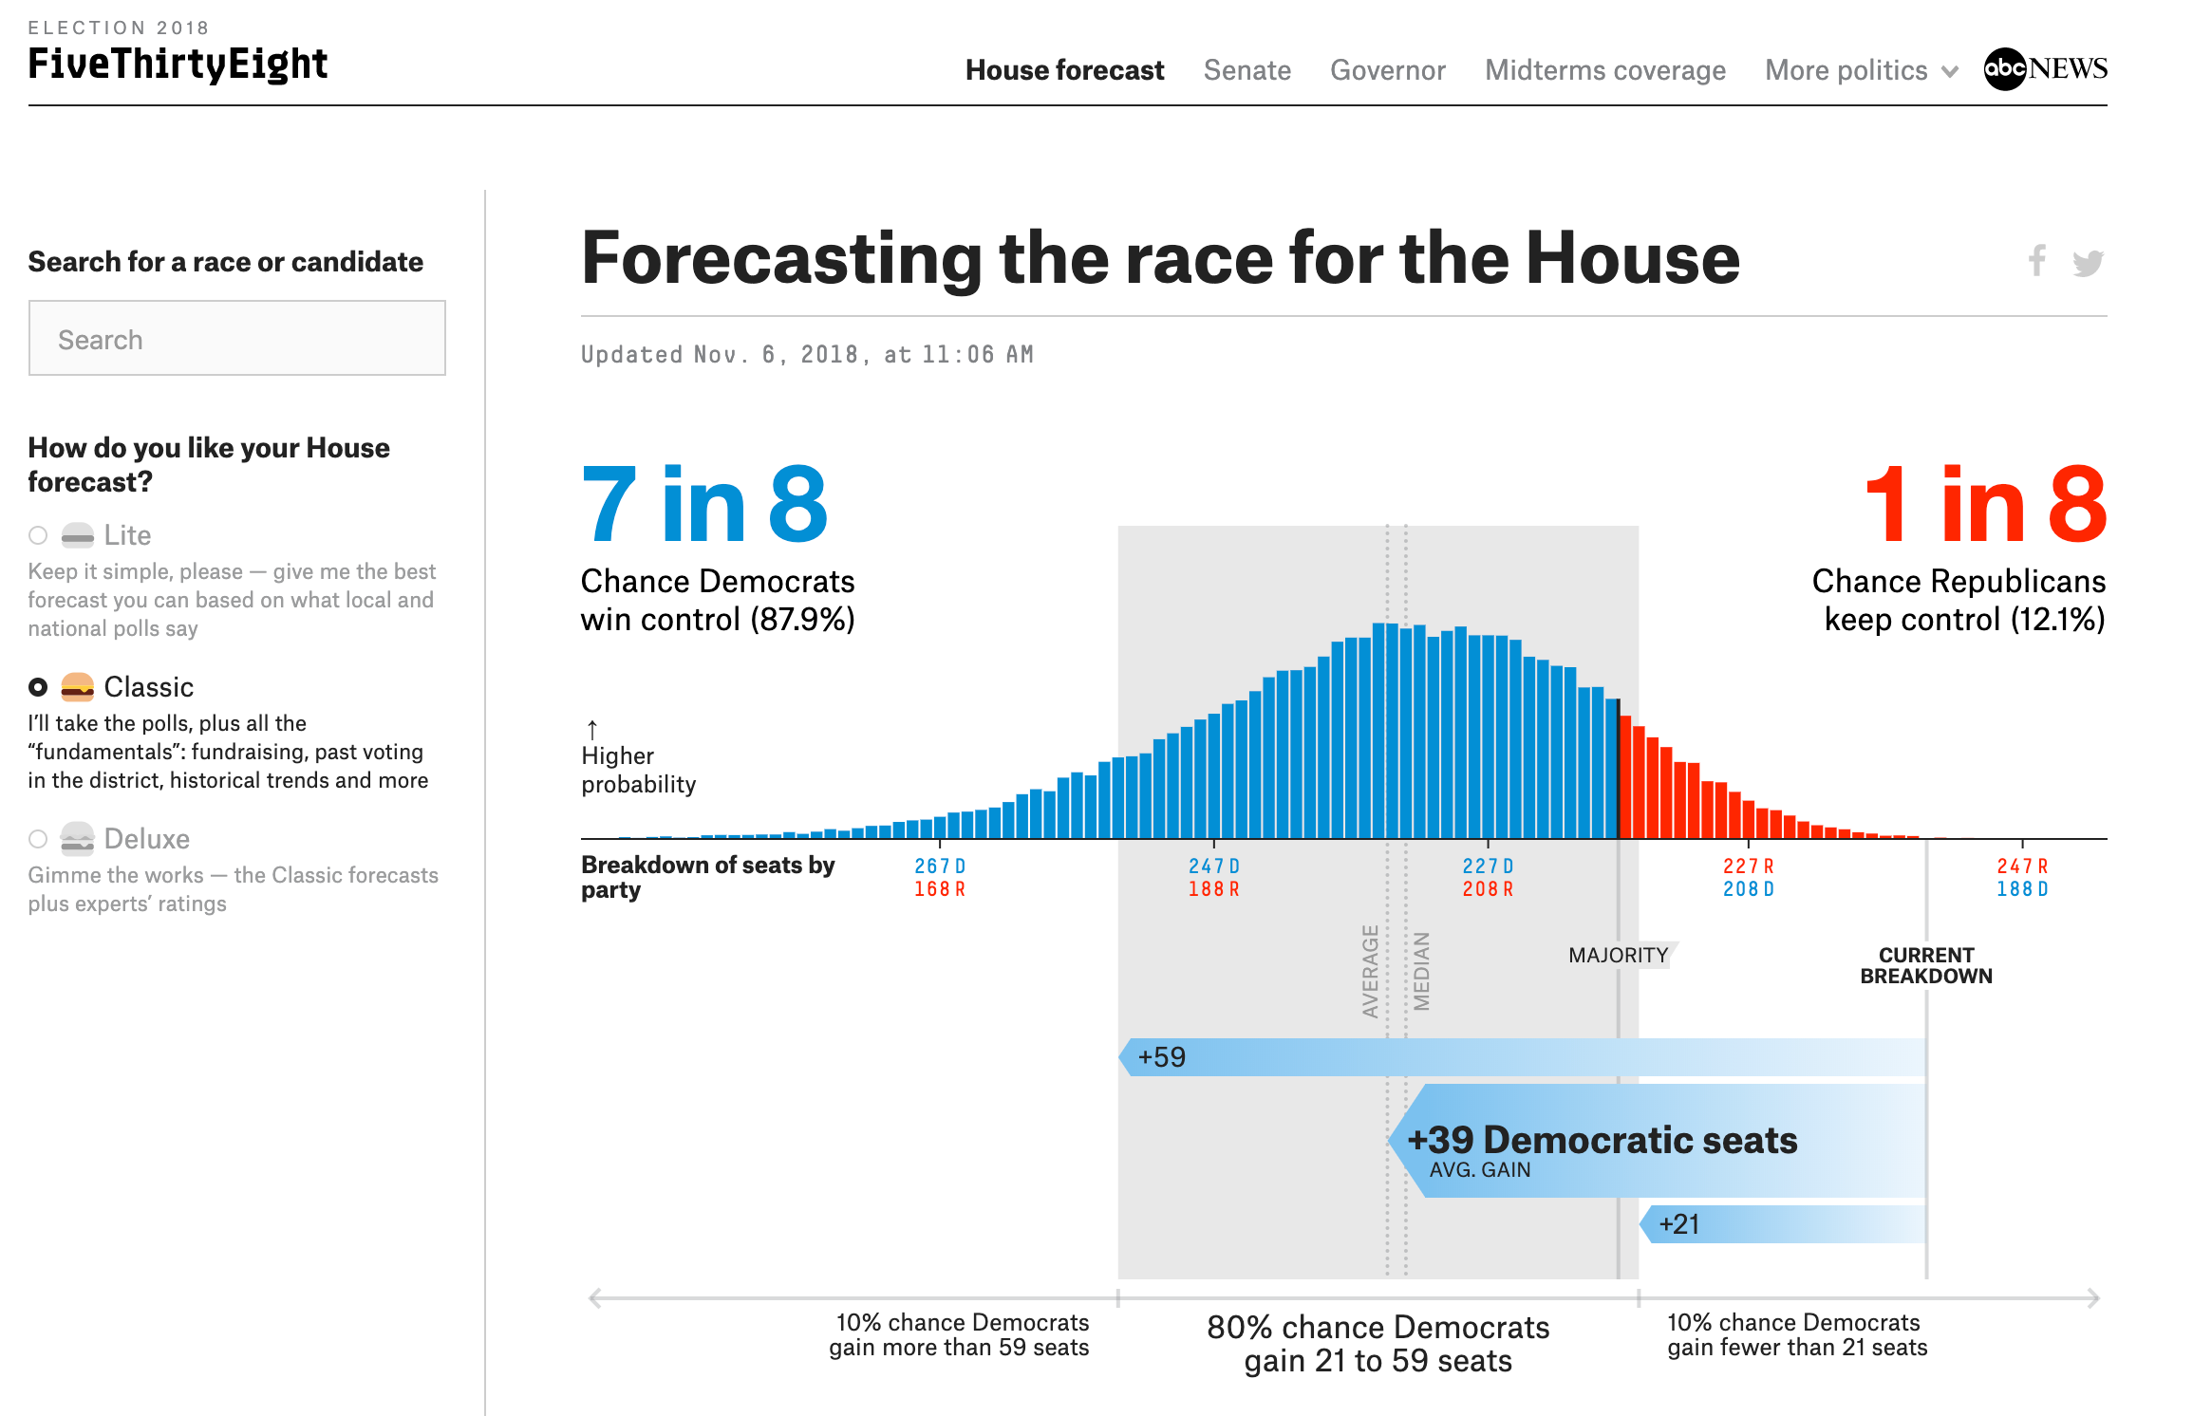
FiveThirtyEight
https://projects.fivethirtyeight.com/2018-midterm-election-forecast/house/

Slide 14
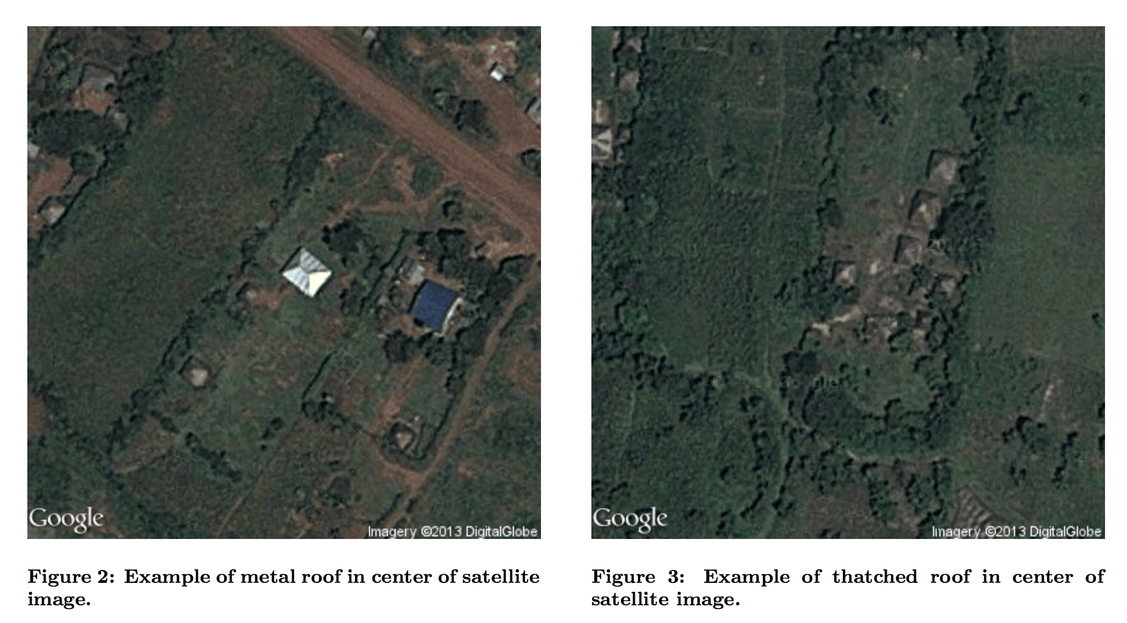
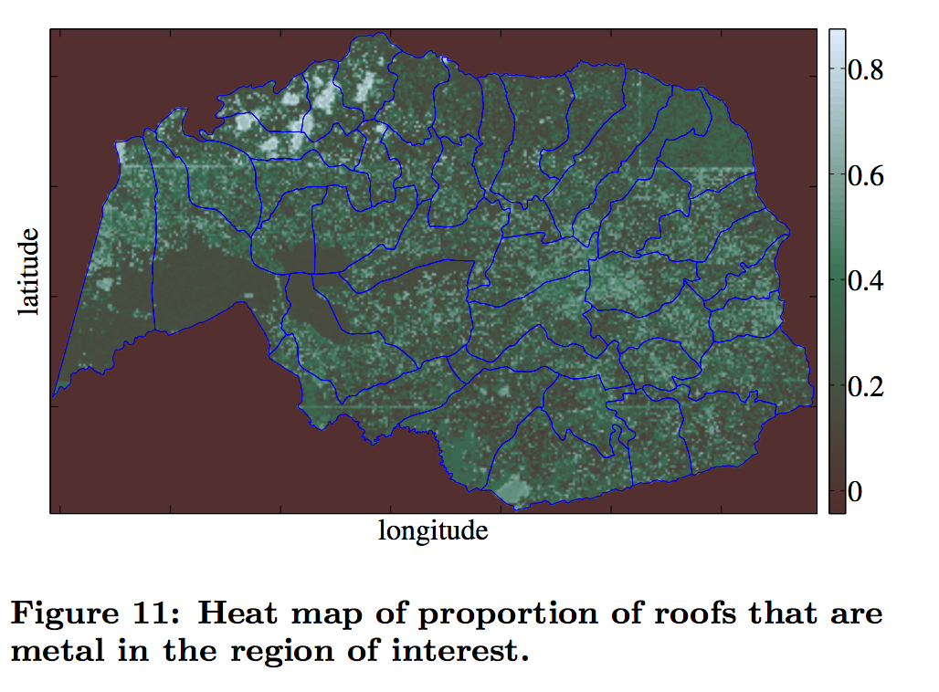
Poverty Mapping
Abelson, Varshney, and
Sun. “Targeting Direct
Cash Transfers to the
Extremely Poor,” 2012

Slide 15
What is data science? Misconception of Data science Data science examples Course objectives and Logistics Introduction to Matlab

Slide 16
Learning objectives of this course
After taking this course, you should…
… understand the full data science pipeline, and be familiar with programming tools to accomplish the different portions
... be able to collect data from unstructured sources and store it using appropriate structure
... know to explore and visualize your data
... be able to analyze your data rigorously using a variety of programming and statistical approaches

Slide 17
Topics covered (subject to change)
Data collection and management: matrices, vectors, graphs
Cleaning up of Data: searching for empty fields and then deleting/ replacing with something different
Statistical modeling: basic probability
Visualization: basic data: visualization, exploration, presentation and interactivity

Slide 18
Course Philosophy
Most of the techniques we will teach in this course are mature tools that you can use in practice
The philosophy of this course is that you will use these tools most effectively when you understand what is going on under the hood
To fully understand the methods – you will also need to implement them

Slide 19
Recommended Background
The only formal prerequisite for this course is an intro to programming
Additionally, it will help if you have some background in probability and statistics, and linear algebra. If you don’t have background in these areas, you may still sign up, but be aware that you will probably need to learn some of these items as the class goes on (will be providing pointers to references)

Slide 20
Course materials
All course material (slides, notes, lecture videos, assignments etc.) will be posted on canvas.
Course Text Books:
Pattern Classification (2nd Edition) – Richard O. Duda, Peter E. Hart, and G. Stork

Slide 21
Grading (Subject to Change)
3 Quizzes @33.33% each (Total 100%)

Slide 22
Student well-being
courses like this can be a little stressful , as some of the topics are high-level
Try to attend every class and ask questions if you don’t understand anything, because if you don’t and try to understand it when you go home from other sources such as the internet etc., the information may be more complicated and difficult to comprehend.

Slide 23
What is data science? Misconception of Data science Data science examples Course objectives and Logistics Introduction to Matlab

Slide 24
Brief Description of Matlab
MATLAB can be taught of as a super – powerful graphing calculator
In addition - it is a programming language
- MATLAB is an interpreted language, like Java
- it is built on the C – programming language
- it has a higher level of interpretation than C
- Commands (code) are executed line by line
One of the key features of Matlab is its toolboxes – these toolboxes contain many functions on key areas, which make research and prototyping easy

Slide 25
- Using Matlab - Scripts - Variables - Arrays - Matrices - Plotting
Topics Covered:

Slide 26
Using Matlab: Help
Help Files: This is the probably the most valuable source of information for learning Matlab on your own
Forums: Experts throughout the world provide online help within hours.
Google – yes a simple Google search may give valuable hits

Slide 27
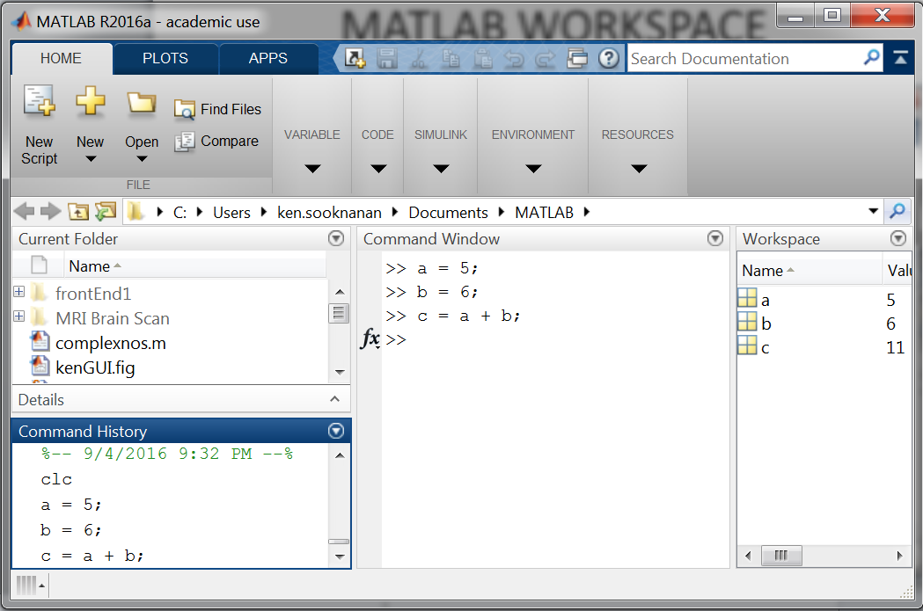
Using MATLAB: WORKSPACE
Command Window
Workspace
History

Slide 28
Using MATLAB: Making Folders
Use folders to keep your programs organized
To make a new folder, click the ‘Browse’ button, next to the ‘Current Directory’ button
Click either the ‘Make New Folder’ button, or right click new-folder. Do NOT use spaces in the folder names. Name the folder – day1
Functions inside the current directory path can be utilized
For complicated programs that use functions located outside the path of the current directory, they should be added to the Path. Use File – set path to accomplish this

Slide 29
- Using Matlab - Scripts - Variables - Arrays - Matrices - Plotting - Functions
Topics Covered:

Slide 30
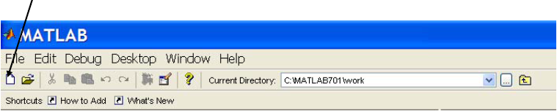
Scripts: Overview
Scripts Properties:
Collection of commands executed in sequence
Written in the Matlab editor
Saved as Matlab files (.m extension)
Creating a Script:
file – new script
Click

Slide 31
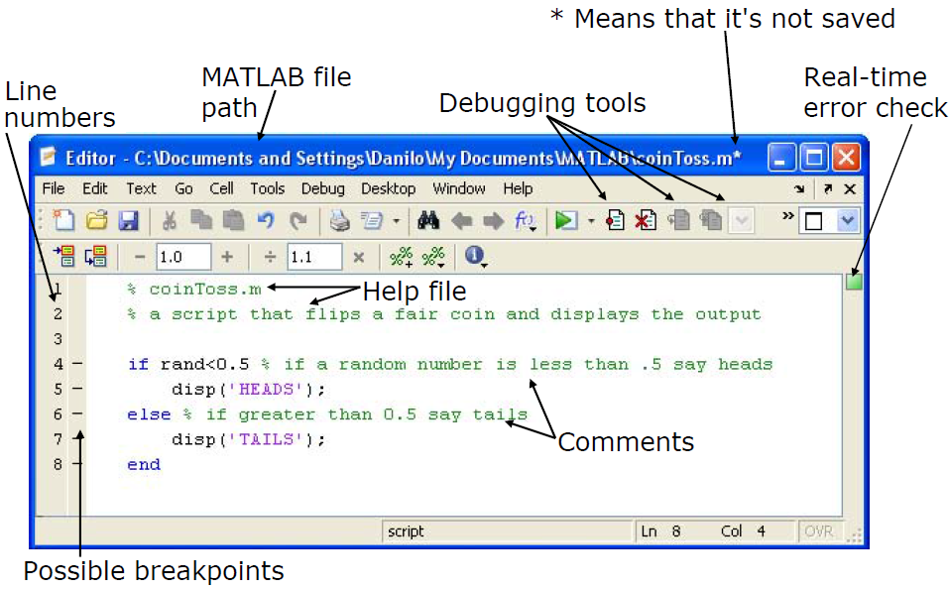
Scripts: the editor

Slide 32
Scripts: Making some notes
COMMENTS
Anything following a % is seen as a comment
The first contiguous comment becomes the script's help file
Comment thoroughly to avoid wasting time later
Note that scripts are somewhat static, since there is no input and no explicit output
All variables created and modified in a script exist in the workspace even after it has stopped running

Slide 33
Scripts: Creating & Running
Create - Create a new M-file and type the following
%% this file is similar to a hello world simulation
disp('I love Matlab')
Save – save the file in the working directory
Run – run the file: click Run (view the Command Window)
you can set break points by clicking the line number
Open – open this file anytime for editing: file - open

Slide 34
- Using Matlab - Scripts - Variables - Arrays - Matrices - Plotting - Functions
Topics Covered:

Slide 35
Variables: Types
MATLAB is a weakly typed language
No need to initialize variables!
MATLAB supports various types, the most often used:
64-bit double (default)
16-bit char
Most variables you’ll deal with will be vectors or matrices of doubles or chars
Other types are also supported: complex numbers, symbolic, 16-bit and 8 bit integers, etc. You will be exposed to all these types through the homework

Slide 36
Variables: Popular Types
DATA TYPE | CLASS NAME | EXPLANATION | EXAMPLE
Floating-Point Numbers | Single, Double | default data type -store real numbers. | A = 1.25125
Integers | int8, uint8, int16, uint16, int32, uint32, int64, uint64 | "u" - unsigned integers,"8,16,32,64" -number of bits for storage. | A = uint16(256)
Characters and Strings | char | store text. String-array of characters | A = 'Hello World'
Boolean | logical | True-1 or false-0 | A = true;
Structures | struct | different data types | A = struct('Name',
Cell Arrays | cell | dif. data lengths | A = cell(2)

Slide 37
Variables: Naming
To create a variable, simply assign a value to a name:
» var1=3.14
» myString = ‘hello world’
Variable names
first character must be a LETTER
after that, any combination of letters, numbers and _
CASE SENSITIVE! (var1is different from Var1)
Built-in variables. Don’t use these names!
i and j can be used to indicate complex numbers
pi has the value 3.1415926…
ans stores the last unassigned value (as a calculator)
Inf and –Inf are positive and negative infinity
NaN represents ‘Not a Number’

Slide 38
Variables: Scalars
A variable can be given a value explicitly
» a = 10
» b = 5
shows up in workspace & in command history!
Or as a function of explicit values and existing variables
» c = a + b
To suppress output, end the line with a semicolon
» c = a – b;

Slide 39
Variables: Save, clear, load
Sometimes it is important to save all variables in the workspace so that you can continue coding another day
To save the entire workspace type – save(‘Sept10’)
To load back the entire workspace – load(‘Sept10’)
To save only particular variables – save(‘Sept10’, ‘a’, ‘b’)
To load a particular variable – load(‘Sept10’, ‘a’)
To clear/delete the entire workspace type – clear
To clear a particular variable – clear a
To clear all variables except some – clearvars –except a

Slide 40
Variables: Complex Numbers
MATLAB allows operations involving complex numbers.
Complex numbers ( ) are entered using i or j.
Number z = 2 + j2 entered in MATLAB as: >> z = 2 + 2i
Magnitude : >> abs(z)
Phase angle : >> angle(z)
**Angle in radians to convert to degrees:

Slide 41
- Using Matlab - Scripts - Variables - Arrays - Matrices - Plotting - Functions
Topics Covered:

Slide 42
Arrays
Like other programming languages, arrays are an important part of MATLAB
One dimensional arrays are commonly referred to as vectors
Arrays of two or more dimensions are commonly referred to as Matrices
Two types of arrays:
- matrix of numbers (either double or complex)
- cell array of objects (more advanced data structure)

Slide 43
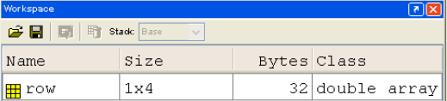
Arrays: Row Vectors
Create a Row vector: use a comma or a space to separate values between brackets
»row = [1 2 5.4 -6.6];
»row = [1, 2, 5.4, -6.6];
Command window: >> row = [1 2 5.4 -6.6]
row = 1.0 2.0 5.4 -6.6
Workspace:

Slide 44
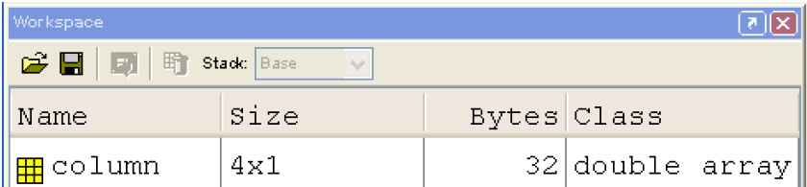
Arrays: Column Vectors
Create a Column vector: use a semicolon to separate values between brackets
» column = [1; 2; 5.4; -6.6];
Command window: >> column = [1; 2; 5.4; -6.6]
column =
1
2
5.4
- 6.6
Workspace:

Slide 45
Arrays: Size & Length
You can tell the difference between a row and a column vector by:
Looking at the size of the array in the workspace
Displaying the variable in the command window
Using the size function
>> size (row) >> size(column)
ans = 1 4 ans = 4 1
The number of elements in an array/vector can also be found using the length function
>> length (row) >> length(column)
ans = 4 ans = 4

Slide 46
Arrays: Automatic Initialization #1
To initialize a linear vector of values use linspace
» a = linspace(0,10,5)
starts at 0, ends at 10 (inclusive), 5 values
Can also use colon operator (:)
» b = 0:2:10
starts at 0, increments by 2, and ends at or before 10
increment can be decimal or negative
» c=1:5
if increment isn’t specified, default is 1
To initialize logarithmically spaced values use logspace
similar to linspace, but see help

Slide 47
Arrays: Automatic Initialization #2
Initialize a vector of ones, zeros, or random numbers
» o = ones(1,10)
row vector with 10 elements, all 1
» z = zeros(23,1)
column vector with 23 elements, all 0
»r = rand(1,45)
row vector with 45 elements (uniform [0,1])
»n = nan(1,69)
row vector of NaNs (useful for representing uninitialized variables)
The general function call is: var = zeros(M,N);
# rows # columns

Slide 48
Arrays: Transpose
The transpose operators turns a column vector into a row vector and vice versa
»a = [1 2 3 4+i]
»transpose(a)
»a'
The ‘ operator gives the Hermitian-transpose, i.e. transposes and conjugates all complex numbers
For vectors of real numbers .'and 'give same result

Slide 49
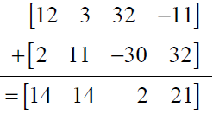
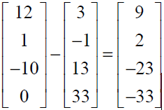
Arrays: Manipulations
Addition and subtraction are element-wise; sizes must match (unless one is a scalar):
The following would give an error
» c = row + column
Transpose to make sizes compatible
» c = row’+ column
» c = row + column’
Can sum up or multiply elements of vector
» s = sum(row);
» p = prod(row);

Slide 50
Arrays: Element-Wise Functions
All functions that work on scalars also work on vectors
»t = [1 2 3];
»f = exp(t);
- is the same as
»f = [exp(1) exp(2) exp(3)];
If in doubt, check a function’s help file to see if it handles vectors element-wise
Operators (* / ^) have two modes of operation
element-wise (have to use a ‘.’ e.g. ‘a.*b’)
Standard (no dot e.g. ‘a*b’)

Slide 51
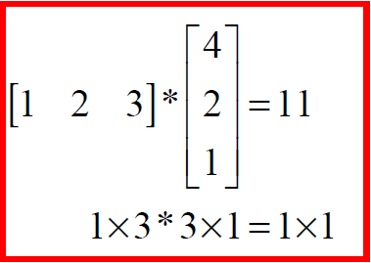
Arrays: Standard Operators
Multiplication can be done standard way or element-wise
Standard matrix multiplication is performed using (*) Remember linear algebra: inner dimensions must Match!

Slide 52
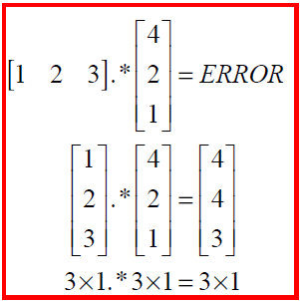
Arrays: Element-Wise Operators
To do element-wise operations, use the dot: .(.*, ./, .^). BOTH dimensions must match (unless one is scalar)!
» a=[1 2 3];b=[4;2;1];
» a.*b, a./b, a.^b - all give errors, as they do not match
» a.*b', a./b’, a.^(b’) - all valid, as they match

Slide 53
Arrays: Indexing
MATLAB indexing starts with 1, not 0
a(n) returns the n^{th} element
The index argument can be a vector. In this case, each element is looked up individually, and returned as a vector of the same size as the index vector.
» x=[12 13 5 8];
» a=x(2:3); a=[13 5];
» b=x(1:end-1); b=[12 13 5];

Slide 54
Question - 1
Get and save the current date and time
Create a variable start using the function clock
What is the size of start? Is it a row or column?
What does start contain? See help clock
Convert the vector start to a string. Use the function datestr and name the new variable startString
Save startand startStringinto a mat file named startTime

Slide 55
Question - Solution
Get and save the current date and time
Create a variable start using the function clock
What is the size of start? Is it a row or column?
What does start contain? See help clock
Convert the vector start to a string. Use the function datestr and name the new variable startString
Save start and startString into a mat file named startTime
»help clock
»start=clock;
»size(start);
»help datestr;
»startString=datestr(start);
»save(‘startTime’, ‘start’, ‘startString’);

Slide 56
- Using Matlab - Scripts - Variables - Arrays - Matrices - Plotting - Functions
Topics Covered:

Slide 57
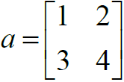






Matrices: Initialization
Matrices created similarly to vectors
(element by element) >> a= [1 2;3 4];
When concatenating vectors or matrices (dim. matters)
» a = [1 2];
» b = [3 4];
» c = [5;6];
» d = [a;b];
» e = [d c];
» f = [[e e];[a b a]];
Strings are character vectors: » str = ['Hello, I am ' 'John'];

Slide 58
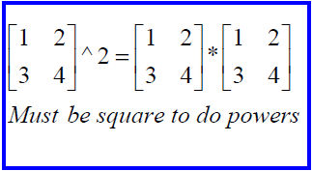
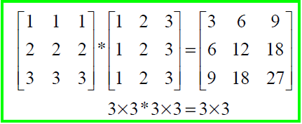
Matrices : Standard Operators
Multiplication can be done standard way or element-wise
Standard matrix multiplication is performed using (*) Remember linear algebra: inner dimensions must Match!
Standard exponentiation (^) can only be done on square matrices or scalars
Left and right division (/ \) is same as multiplying by inverse (i.e. just multiply by inverse)

Slide 59
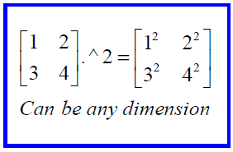
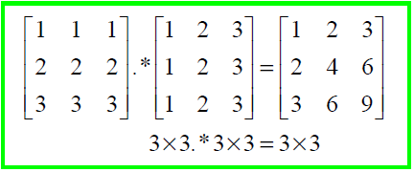
Matrices : Element-Wise Operators
To do element-wise operations, use the dot: .(.*, ./, .^). BOTH dimensions must match (unless one is scalar)!

Slide 60
Matrices: Indexing - #1
MATLAB indexing starts with 1, not 0
a(n) returns the n^{th} element
The index argument can be a vector. In this case, each element is looked up individually, and returned as a vector of the same size as the index vector.
» x=[12 13 5 8];
» a=x(2:3); a=[13 5];
» b=x(1:end-1); b=[12 13 5];

Slide 61
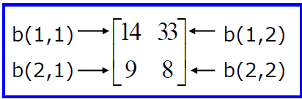
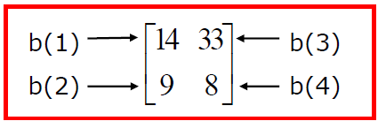
Matrices: Indexing #2
Matrices can be indexed in two ways
using subscripts(row and column)
using linear indices(as if matrix is a vector)
Matrix indexing: subscripts or linear indices
Picking submatrices
» A = rand(5) % shorthand for 5x5 matrix
» A(1:3,1:2) % specify contiguous submatrix
» A([1 5 3], [1 4]) % specify rows and columns

Slide 62
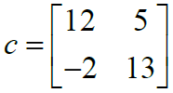
Matrices: Indexing #3
To select rows or columns of a matrix, use the :
» d = c(1,:); d=[12 5];
» e = c(:,2); e=[5;13];
» c(2,:) = [3 6]; %replaces second row of c

Slide 63
Matrices: Indexing #4
MATLAB contains functions to help you find desired values within a vector or matrix
»vec = [5 3 1 9 7]
To get the minimum value and its index:
»[minVal,minInd] = min(vec);
max works the same way
To find any the indices of specific values or ranges
»ind = find(vec == 9);
»ind = find(vec > 2 & vec < 6);

Slide 64
- Using Matlab - Scripts - Variables - Arrays - Matrices - Plotting
Topics Covered:

Slide 65
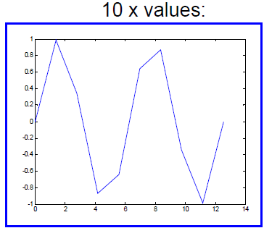
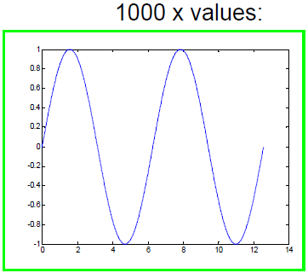
Plotting: Using the plot function
plot(x, y) generates dots at each (x,y) pair and then connects the dots with a line.
» x= 1:0.5:100;
» y = sin(x); % x and y must be the same size
» plot(x, y);
Use more points to make a plots look smoother

Slide 66
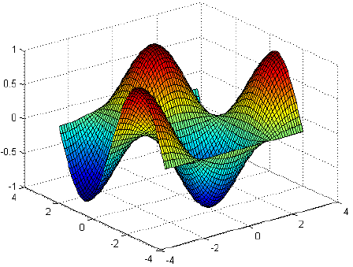
Plotting: Using the surf function
Make the x and y vectors
» x=-pi:0.1:pi;
» y=-pi:0.1:pi;
Use meshgrid to make matrices (this is the same as loop)
»[X,Y]=meshgrid(x,y);
Get the Z (ifunction) values
» Z =sin(X).*cos(Y);
Plot the surface
» surf(X,Y,Z)
» surf(x,y,Z);

